Slide 1



Introduction to EDT Mobile
Abraham Blom
EDT Mobile Training
13-16 May 2013

Slide 2
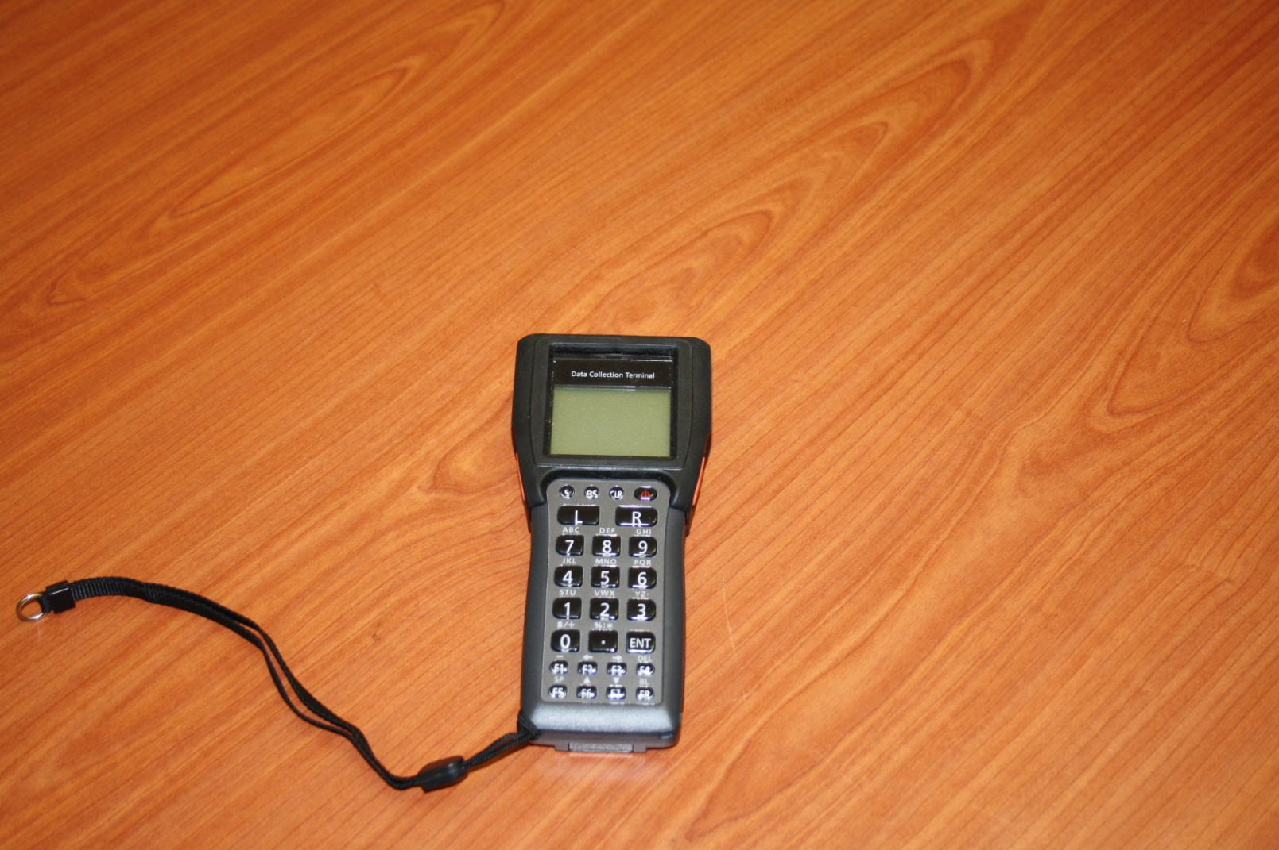
EDT Mobile Device

Slide 3
Dispensing with Mobile Device - Objective
By the end of this session you should be able to:
Use the EDT mobile to record dispensing details
Properly maintain the mobile devices

Slide 4
Main Processes of Mobile Data Capturing
Data is loaded from the EDT computer onto the device at the Main Site
Dispensing and other patient management tasks are done at the IMAI site
Data is imported to the EDT computer at the main site; ART Monthly Reports are compiled
Data is transferred to Head Office via MTC 3G network

Slide 5
Using the EDT mobile
The EDT Mobile should be updated on a monthly basis with the complete patient list from the EDT at the main site (Process 1). This should be done after downloading data from the device to the EDT (Process 3).
EDT Mobile is used in the following scenarios:
Dispensing at outreach sites
Dispensing at IMAI sites (introduced now)
Dispensing at main site, including when the EDT is not working or when you have more pharmacy staff to dispense to patients.

Slide 6
Using the EDT mobile cont.
Implications
Eliminates duplication of work, and manual data capturing
Improves facility ART service efficiency
The following cannot be done:
Change a patient’s regimen
Change a patient’s outreach site
Calculate a patient’s adherence
Generate reports
Cannot do quantification
All the above is done at the main site, with the data from the mobile device, the recruitment form and the completed appointment list

Slide 7
EDT Mobile Menus
Power Button – switch on and off
S – second function button
BS – Back Space button
CLR – Clear button
L – Left Scan button
R – Right Scan button
ENT – Enter button – use to confirm
F1 – dash button
F2 – Backwards button(2nd function)
F3 – Forward button(2nd function)
F4 – Delete button (2nd function)
F8 – Backlight button (2nd function)

Slide 8
Process 1: Load Data onto the Devices
Complete Step 1 in EDT to create the files
Click on “Link” on Step 2 to open communications to the device
Place the device in cradle; Select Setup (9) then Load Files (4) on the device, and press ‘ENT’.
Wait for files to finish transferring and converting, “SETUP” menu will appear once loading is done
Device is now ready to be used for dispensing

Slide 9
Process 2: Dispensing Steps
Go to main menu ‘EDT930’ (press “CLR” until you are on the main menu)
Select “1” for Dispense Medicines
Enter password: 1234 and confirm through ENT
Enter ART number of patient and confirm through ENT
Enter number of days to next appointment and confirm through ENT
Enter OR scan medicine code and confirm through ENT
Enter pill count for medicine and confirm through ENT
Enter quantity dispensed and through ENT
Repeat Steps 6 – 8 for additional medicines to dispense
Press “CLR” twice to end and proceed to next patient

Slide 10
Process 3: Send files back to computer
Select the “Export to Mobile” menu on the EDT
Click on “Link” on Step 3 to open communications to the device
Place the device in cradle; Select Send Data (Enter 2) and enter password: 1234 and confirm through ENT
To confirm file transfer press ‘ENT’.
On the EDT (Step 4) click Browse and select the *EDT.TXT file to import.
Continue with Step 5 to verify and complete data import.
To close the mobile session click ‘Done’ in Step 6. (This is an optional Step when previous import failed)

Slide 11
Intro:
Switch ON device
Familiarise with menus
Setup clock
Set Com Type
Software Update
Load Files
Dispense medicine
ART nr - 27-1435
Regimen - AZT/3TC/EFV
Medicines to dispense:
AZT300/3TC150 and EFV600
Nr of Days Dispense – 28
Pill Count – 4, 2

Slide 12
THANK YOU

